Slide 1
Unit 2

Slide 2
Logical Agents
Knowledge-based agents – agents that have an explicit representation of knowledge that can be reasoned with.
These agents can manipulate this knowledge to infer new things at the “knowledge level”

Slide 3
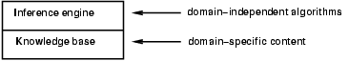
Knowledge bases
Knowledge base = set of sentences in a formal language
Declarative approach to building an agent (or other system):
Tell it what it needs to know
Then it can Ask itself what to do - answers should follow from the KB
Tells the KB which action was chosen
Agents can be viewed at the knowledge level - i.e., what they know, regardless of how implemented
Or at the implementation level
i.e., data structures in KB and algorithms that manipulate them

Slide 4
Knowledge base
Knowledge level – need to specify what the agent know and its goals
Implementation level – actual action being performed for carrying out the goal
Declarative approach – KB agent by Telling it what it needs to know
Procedural approach – Encodes desired behaviors directly as program code

Slide 5
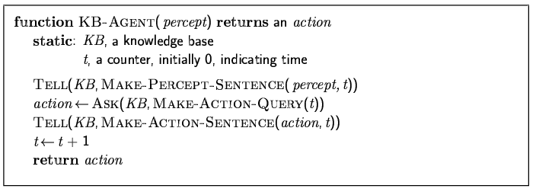
A simple knowledge-based agent
The agent must be able to:
Represent states, actions, etc.
Incorporate new percepts
Update internal representations of the world
Deduce hidden properties of the world
Deduce appropriate actions
Notes:
KB agent maintains a knowledge base which may initially contain background information. Each time the program is called, it (1) tells the KB what it perceives, (2) it asks the knowledge base what it should do, (3) it tells the KB what it does and time moves on…

Slide 6
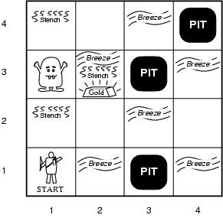
A Wumpus World
Cave and has rooms
There is a Wumpus which eats anyone who enters
Agent can shoot the Wumpus but only one arrow
Some rooms has PIT that will trap
Goal – find the gold
Notes:
To get an idea of what a KB agent can do, let’s consider the Wumpus World.
A cave consisting of rooms connected by passageways. Lurking somewhere is a wumpus – a beast who eats anyone who enters the room. The wumpus stinks (and you can smell him a room away). Some rooms contain bottomless pits that will trap anyone who wanders in (there is a breeze in rooms next to the pit). The goal is to reach the gold (you know it is in the room because it glitters).

Slide 7
Wumpus World PEAS description
Performance measure
gold +1000, death -1000
-1 per step, -10 for using the arrow
Environment: 4 x 4 grid of rooms
Squares adjacent to wumpus are smelly
Squares adjacent to pit are breezy
Glitter iff gold is in the same square
Shooting kills wumpus if you are facing it
Shooting uses up the only arrow
Grabbing picks up gold if in same square
Releasing drops the gold in same square
Sensors: Stench, Breeze, Glitter, Bump, Scream (shot Wumpus)
Actuators: Left turn, Right turn, Forward, Grab, Release, Shoot
Notes:
Agent always starts in square [1,1] facing right. Locations of the gold and the wumpus are chosen randomly (from squares other than the start square)

Slide 8
Wumpus world characterization
Fully Observable
Deterministic
Episodic
Static
Discrete
Single-agent?
Notes:
Fully Observable – does sensors give access to full state of the environment?

Slide 9
Wumpus world characterization
Fully Observable No – only local perception
Deterministic
Episodic
Static
Discrete
Single-agent?
Notes:
Deterministic – is the next state completely determined by the current state and the action executed by the agent or is there some uncertaintity?

Slide 10
Wumpus world characterization
Fully Observable No – only local perception
Deterministic Yes – outcomes exactly specified
Episodic
Static
Discrete
Single-agent?
Notes:
Episodic (or sequential) – episodic means divided into independent atomic episodes (like an assembly line robot where decisions about the current part does not affect the decision on the next part) or Sequential – where current action affects future environments.

Slide 11
Wumpus world characterization
Fully Observable No – only local perception
Deterministic Yes – outcomes exactly specified
Episodic No – sequential at the level of actions
Static
Discrete
Single-agent?
Notes:
Static or dynamic? Does the world change as time goes by?

Slide 12
Wumpus world characterization
Fully Observable No – only local perception
Deterministic Yes – outcomes exactly specified
Episodic No – sequential at the level of actions
Static Yes – Wumpus and Pits do not move
Discrete
Single-agent?
Notes:
Discrete versus continuous

Slide 13
Wumpus world characterization
Fully Observable No – only local perception
Deterministic Yes – outcomes exactly specified
Episodic No – sequential at the level of actions
Static Yes – Wumpus and Pits do not move
Discrete Yes
Single-agent?
Notes:
Vs multi-agent?

Slide 14
Wumpus world characterization
Fully Observable No – only local perception
Deterministic Yes – outcomes exactly specified
Episodic No – sequential at the level of actions
Static Yes – Wumpus and Pits do not move
Discrete Yes
Single-agent? Yes – Wumpus is essentially a natural feature

Slide 15
Wumpus World
Percepts given to the agent
Stench
Breeze
Glitter
Bumb (ran into a wall)
Scream (wumpus has been hit by arrow)
Principle Difficulty: agent is initially ignorant of the configuration of the environment – going to have to reason to figure out where the gold is without getting killed!
Notes:
Agent always starts in square [1,1] facing right. Locations of the gold and the wumpus are chosen randomly (from squares other than the start square).
Note the agent perceives the environment - percept looks like
[stench, breeze, glitter, bump, scream]
Let’s see how the knowledge-based agent would explore the world – trying to learn whether or not it can locate the gold without getting killed.

Slide 16
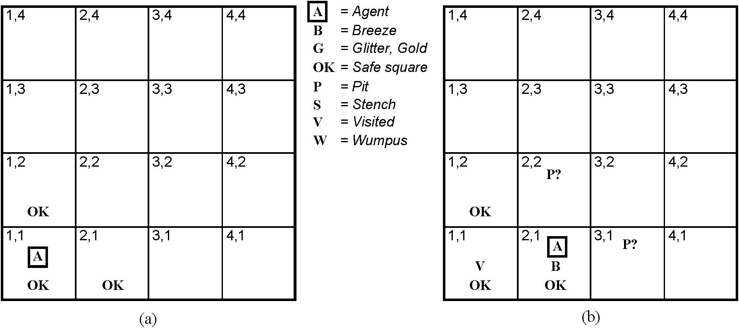
Exploring the Wumpus World
Initial situation:
Agent in 1,1 and percept is
[None, None, None, None, None]
From this the agent can infer the neighboring squares are safe (otherwise there would be a breeze or a stench)
Notes:
We will mark down what we know – initially the agent (A) is in 1,1, and we know that that square is OK.
It then gets the first percept – remember order is
[stench, breeze, glitter, bump, scream] – and first percept has these all null.
A cautious agent will move only into a square it knows to be OK.

Slide 17
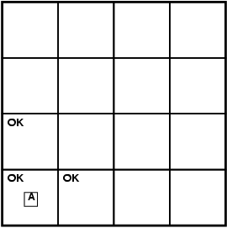
Exploring a wumpus world
Notes:
In initial state, there are no percepts (the sequence is none, none, none, none, none) and therefore it can be inferred that the neighboring squares are safe (OK).

Slide 18
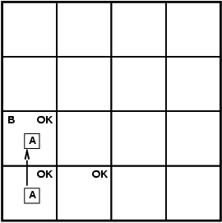
Exploring a wumpus world
Notes:
The agent decides to move up and feels a breeze – what does this mean?

Slide 19
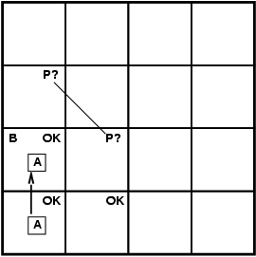
Exploring a wumpus world
Notes:
That there is a pit in either of the two neighboring squares. Better not move there since it knows there is a safer move if it backs up…

Slide 20
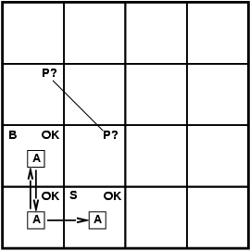
Exploring a wumpus world
Notes:
So it does – and what can it infer from there?

Slide 21
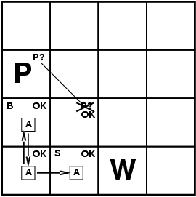
Exploring a wumpus world
Notes:
A pretty difficult inference!; note how difficult because of the inference of where the pit is depends on the lack of a percept (no B in 2,1) and percepts gathered over time.

Slide 22

Exploring a wumpus world

Slide 23
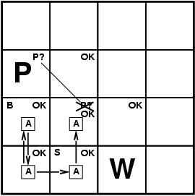
Exploring a wumpus world

Slide 24
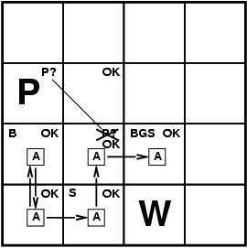
Exploring a wumpus world
Notes:
The agent wins!

Slide 25
Exploring a wumpus world
In each case where the agent draws a conclusion from the available
Information, that conclusion is guaranteed to be correct if the available
Information is correct…
This is a fundamental property of logical reasoning
Notes:
The agent wins!

Slide 26
Logic in general
Logics are formal languages for representing information such that conclusions can be drawn
Syntax defines how symbos can be put together to form the sentences in the language
Semantics define the "meaning" of sentences;
i.e., define truth of a sentence in a world (given an interpretation)
E.g., the language of arithmetic
x+2 ≥ y is a sentence; x2+y > {} is not a sentence
x+2 ≥ y is true iff the number x+2 is no less than the number y
x+2 ≥ y is true in a world where x = 7, y = 1
x+2 ≥ y is false in a world where x = 0, y = 6
Notes:
Let’s see how we can do that kind of reasoning.
In order to have a logic, we need to have a couple of things…
In standard logics, every sentence must be either true or false in each possible world – there is no in between.

Slide 27
Entailment
Entailment means that one thing follows logically from another:
KB ╞ α
Knowledge base KB entails sentence α if and only if α is true in all worlds where KB is true
E.g., the KB containing “the Phillies won” and “the Reds won” entails “Either the Phillies won or the Reds won”
E.g., x+y = 4 entails 4 = x+y
Entailment is a relationship between sentences (i.e., syntax) that is based on semantics
Notes:
Here you want to see a possible world as a mapping of the sentences into t or f in the possible world.

Slide 28
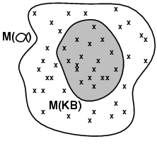
Models
Logicians typically think in terms of models, which are formally structured worlds with respect to which truth can be evaluated
We say m is a model of a sentence α if α is true in m
M(α) is the set of all models of α
Then KB ╞ α iff M(KB) ⊆ M(α)
E.g. KB = Phillies won and
Yankees won α = Phillies won

Slide 29
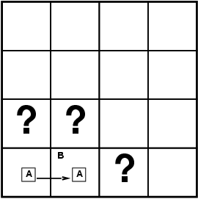
Entailment in the wumpus world
Situation after detecting nothing in [1,1], moving right, breeze in [2,1]
Consider possible models for KB assuming only pits
3 Boolean choices ⇒ 8 possible models
Notes:
The percepts and the agent’s knowledge of the rules of the game (from the PEAS description) constitute the KB. The agent wants to know if the adjacent squares contain pits. Each may or may not contain a pit – so

Slide 30
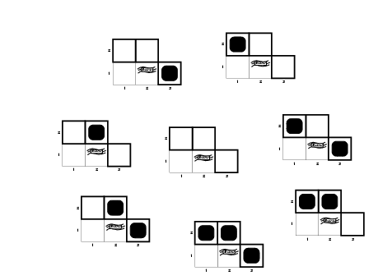
Wumpus possible models
Notes:
Although the figure shows possible wumpus worlds, they are really nothing more than assignments of true and false to the sentences “there is a pit in …” [1,2], [2,2], [3,1]

Slide 31
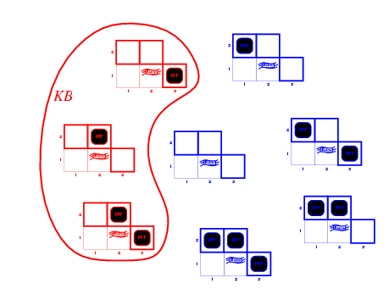
Wumpus models
KB = wumpus-world rules + observations
Notes:
The KB is false in models that contradict what the agent knows – there are just 3 models in which the KB is true. Go through and recognize why… both the true and the false cases.
e.g., KB is false in any models in which [1,2] contains a pit, because there is no breeze in [1,1]

Slide 32
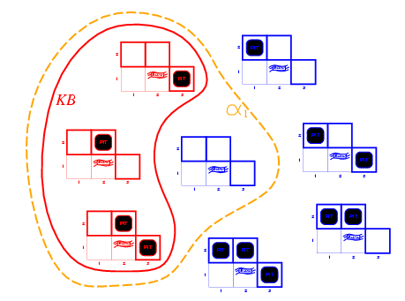
Wumpus models
KB = wumpus-world rules + observations
α₁ = “there is no pit in [1,2]", KB ╞ α₁, proved by model checking
Notes:
Model checking – enumerate all possible models, and check to see that alpha is true in all models in which KB is true (and then it must be the case that the KB entails alpha).

Slide 33
Wumpus models
KB = wumpus-world rules + observations

Slide 34
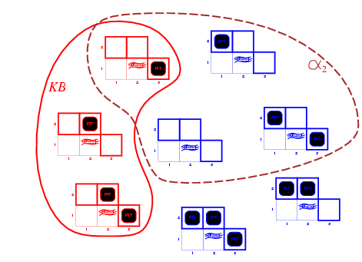
Wumpus models
KB = wumpus-world rules + observations
α₂ = “there is no pit in [2,2]", KB ╞ α₂

Slide 35
Inference and Entailment
Inference is a procedure that allows new sentences to be derived from a knowledge base.
Understanding inference and entailment: think of
Set of all consequences of a KB as a haystack
α as the needle
Entailment is like the needle being in the haystack
Inference is like finding it
Notes:
So, these examples not only show entailment, but also how entailment can be used to derive conclusions.

Slide 36
Inference
KB ├_{i} α = sentence α can be derived from KB by inference procedure I
Soundness: i is sound if whenever KB ├_{i} α, it is also true that KB╞ α
Completeness: i is complete if whenever KB╞ α, it is also true that KB ├_{i} α
Preview: we will define a logic (first-order logic) which is expressive enough to say almost anything of interest, and for which there exists a sound and complete inference procedure.
That is, the procedure will answer any question whose answer follows from what is known by the KB.
Notes:
Alpha is derived from KB by i

Slide 37
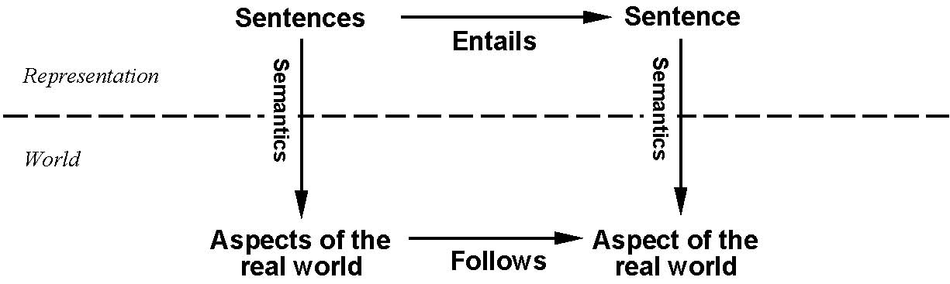
Step Back…
This is an inference procedure whose conclusions are guaranteed to be true
In any world where the premises are true.
If KB is true in the real world, then any sentence α derived
from KB by a sound inference procedure is also true in
the real world.
Notes:
We have described an inference procedure whose conclusions are guaranteed to be true in any world in which the premises are true.
Note – the inference procedure operates on syntax – and we can conclude things about the semantics of other sentences in the real world – a very powerful thing.

Slide 38
Propositional logic: Syntax
Propositional logic is the simplest logic – illustrates basic ideas
The proposition symbols P₁, P₂ etc are (atomic) sentences
If S is a sentence, ¬(S) is a sentence (negation)
If S₁ and S₂ are sentences, (S₁ ∧ S₂) is a sentence (conjunction)
If S₁ and S₂ are sentences, (S₁ ∨ S₂) is a sentence (disjunction)
If S₁ and S₂ are sentences, (S₁ ⇒ S₂) is a sentence (implication)
If S₁ and S₂ are sentences, (S₁ ⇔ S₂) is a sentence (biconditional)
Notes:
Let’s show a simple but powerful logic – called propositional logic. In defining a logic we need to specify its syntax and its semantics – and then we can look at entailment.
Syntax defines allowable sentences. Atomic sentences (propositions) are the smallest bit of thing that one could be “true” or “false”. T and F (true and false) are propositional sentences. From these we use connectives to build up more complicated sentences… I have shown the () here, but they can be dropped w/o loss of generality if we define a precedence order on the operators with not having the highest precedence. Notice the recursive definition.

Slide 39
Propositional logic: Semantics
Each model specifies true/false for each proposition symbol
E.g. P_{1,2} P_{2,2} P_{3,1}
false true false
With these symbols, 8 possible models, can be enumerated automatically.
Rules for evaluating truth with respect to a model m:
¬S is true iff S is false
S₁ ∧ S₂ is true iff S₁ is true and S₂ is true
S₁ ∨ S₂ is true iff S₁is true or S₂ is true
S₁ ⇒ S₂ is true iff S₁ is false or S₂ is true
i.e., is false iff S₁ is true and S₂ is false
S₁ ⇔ S₂ is true iff S₁⇒S₂ is true andS₂⇒S₁ is true
Simple recursive process evaluates an arbitrary sentence, e.g.,
¬P_{1,2} ∧ (P_{2,2} ∨ P_{3,1}) = true ∧ (true ∨ false) = true ∧ true = true
Notes:
The semantics defines the rules for determining the truth of a sentence with respect to a particular model – a mapping of the atomic symbols into true and false. The semantics of a logic must say how to compute the truth value of any sentence, given a model.
This is done recursively – by specifying how to compute the semantics of sentences using the 5 connectives.

Slide 40
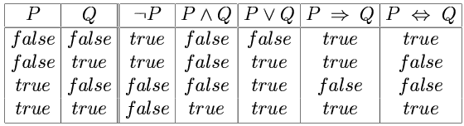
Truth tables for connectives
Notes:
Using the tables, we can compute the truth value of a complex sentence recursively (as we saw on the previous slide).

Slide 41
Truth tables for connectives
John likes football and John likes baseball.
John likes football or John likes baseball.
(English or is a bit different…)
Notes:
Notice some intuitions with respect to corresponding English sentences:

Slide 42
Truth tables for connectives
John likes football and John likes baseball.
John likes football or John likes baseball.
If John likes football then John likes baseball.
(Note different from English – if John likes football maps to false, then the sentence is true.)
(Implication seems to be if antecedent is true then I claim the consequence is, otherwise I make no claim.)
Notes:
Notice some intuitions with respect to corresponding English sentences:

Slide 43
Wumpus world sentences
Let P_{i,j} be true if there is a pit in [i, j].
Let B_{i,j} be true if there is a breeze in [i, j].
¬ P_{1,1}
¬B_{1,1}
B_{2,1}
"Pits cause breezes in adjacent squares“
B_{1,1} ⇔ (P_{1,2} ∨ P_{2,1})
B_{2,1} ⇔ (P_{1,1} ∨ P_{2,2} ∨ P_{3,1})

Slide 44
Simple Inference Procedure
KB╞ α?
Model checking – enumerate the models, and check if α is true in every model in which KB is true. Size of truth table depends on # of atomic symbols.
Remember – a model is a mapping of all atomic symbols to true or false – use semantics of connectives to come to an interpretation for them.

Slide 45
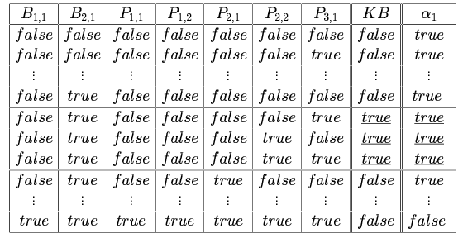
Truth tables for inference
Notes:
This is taken from the text – meant to show how you need to enumerate all possibilities – then look in the lines of the table where the KB is true.

Slide 46
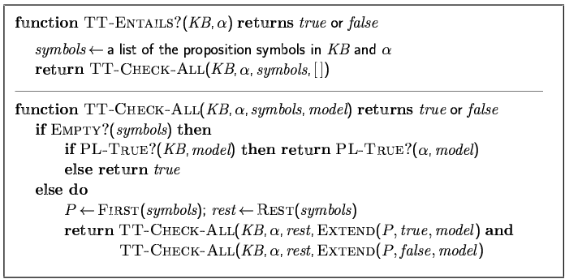
Inference by enumeration
Depth-first enumeration of all models is sound and complete
For n symbols, time complexity is O(2^{n}), space complexity is O(n)

Slide 47
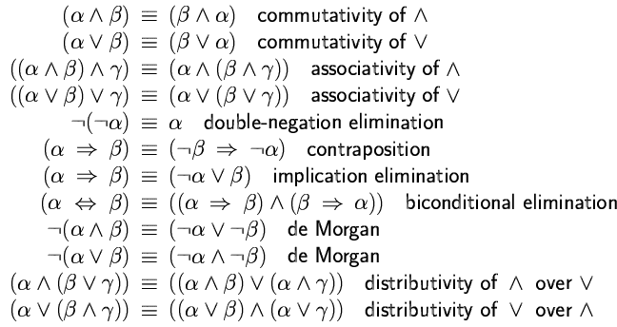
Logical equivalence
Two sentences are logically equivalent iff true in same models: α ≡ ß iff α╞ β and β╞ α

Slide 48
Validity and satisfiability
A sentence is valid if it is true in all models,
e.g., True, A ∨¬A, A ⇒ A, (A ∧ (A ⇒ B)) ⇒ B
Validity is connected to inference via the Deduction Theorem:
KB ╞ α if and only if (KB ⇒ α) is valid
A sentence is satisfiable if it is true in some model
e.g., A∨ B, C
A sentence is unsatisfiable if it is true in no models
e.g., A∧¬A
Satisfiability is connected to inference via the following:
KB ╞ α if and only if (KB ∧¬α) is unsatisfiable

Slide 49
Proof methods
Proof methods divide into (roughly) two kinds:
Application of inference rules
Legitimate (sound) generation of new sentences from old
Proof = a sequence of inference rule applications Can use inference rules as operators in a standard search algorithm
Typically require transformation of sentences into a normal form
Model checking
truth table enumeration (always exponential in n)
improved backtracking, e.g., Davis--Putnam-Logemann-Loveland (DPLL)
heuristic search in model space (sound but incomplete)
e.g., min-conflicts-like hill-climbing algorithms

Slide 55
Conversion to CNF
B_{1,1} ⇔ (P_{1,2} ∨ P_{2,1})
Eliminate ⇔, replacing α ⇔ β with (α ⇒ β)∧(β ⇒ α).
(B_{1,1} ⇒ (P_{1,2} ∨ P_{2,1})) ∧ ((P_{1,2} ∨ P_{2,1}) ⇒ B_{1,1})
2. Eliminate ⇒, replacing α ⇒ β with ¬α∨ β. (¬B_{1,1} ∨ P_{1,2} ∨ P_{2,1}) ∧ (¬(P_{1,2} ∨ P_{2,1}) ∨ B_{1,1})
3. Move ¬ inwards using de Morgan's rules and double-negation:
(¬B_{1,1} ∨ P_{1,2} ∨ P_{2,1}) ∧ ((¬P_{1,2} ∨ ¬P_{2,1}) ∨ B_{1,1})
4. Apply distributivity law (∧ over ∨) and flatten: (¬B_{1,1} ∨ P_{1,2} ∨ P_{2,1}) ∧ (¬P_{1,2} ∨ B_{1,1}) ∧ (¬P_{2,1} ∨ B_{1,1})

Slide 56
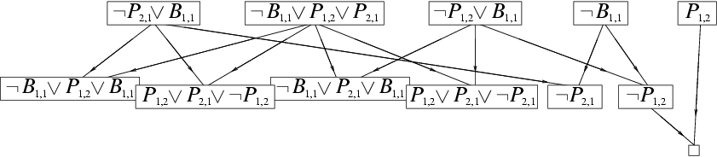
Resolution example
KB = (B_{1,1} ⇔ (P_{1,2}∨ P_{2,1})) ∧¬ B_{1,1} α = ¬P_{1,2}

Slide 62
Propositional logic semantics: The unvarnished truth
function PL-TRUE?(α,model) returns true or false
if α is a symbol then return Lookup(α, model)
if Op(α) = ¬ then return not(PL-TRUE?(Arg1(α),model))
if Op(α) = ∧ then return and(PL-TRUE?(Arg1(α),model),
PL-TRUE?(Arg2(α),model))
if Op(α) = ⇒ then return or(PL-TRUE?(Arg1(α),model),
not(PL-TRUE?(Arg2(α),model)))
etc. (Sometimes called “recursion over syntax”)

Slide 63
Simple theorem proving: Forward chaining
Forward chaining applies Modus Ponens to generate new facts:
Given X₁ ∧ X₂ ∧ … X_{n} ⇒ Y and X₁, X₂, …, X_{n}
Infer Y
Forward chaining keeps applying this rule, adding new facts, until nothing more can be added
Requires KB to contain only definite clauses:
(Conjunction of symbols) ⇒ symbol; or
A single symbol (note that X is equivalent to True ⇒ X)

Slide 64
Forward chaining algorithm
function PL-FC-ENTAILS?(KB, q) returns true or false count ← a table, where count[c] is the number of symbols in c’s premise
inferred ← a table, where inferred[s] is initially false for all s
agenda ← a queue of symbols, initially symbols known to be true in KB
while agenda is not empty do
p ← Pop(agenda) if p = q then return true
if inferred[p] = false then
inferred[p]←true for each clause c in KB where p is in c.premise do
decrement count[c]
if count[c] = 0 then add c.conclusion to agenda
return false

Slide 65
Forward chaining example: Proving Q
Clauses
Count
Inferred
P ⇒ Q
L ∧ M ⇒ P
B ∧ L ⇒ M
A ∧ P ⇒ L
A ∧ B ⇒ L
A
B
1
2
2
2
2
0
0
A false
B false
L false
M false
P false
Q false
// 0
xxxx true
// 1
xxxx true
// 0
// 0
xxxx true
// 1
// 0
xxxx true
// 1
xxxx true
// 0
// 1
xxxx true
Agenda
x
x
Q
x
L
x
x
x
M
P
A B
x
L

Slide 66
Properties of forward chaining
Theorem: FC is sound and complete for definite-clause KBs
Soundness: follows from soundness of Modus Ponens (easy to check)
Completeness proof:
1. FC reaches a fixed point where no new atomic sentences are derived
2. Consider the final inferred table as a model m, assigning true/false to symbols
3. Every clause in the original KB is true in m
Proof: Suppose a clause a₁∧... ∧a_{k} ⇒ b is false in m
Then a₁∧... ∧a_{k} is true in m and b is false in m
Therefore the algorithm has not reached a fixed point!
4. Hence m is a model of KB
5. If KB |= q, q is true in every model of KB, including m
A false
B false
L false
M false
P false
Q false
xxxx true
xxxx true
xxxx true
xxxx true
xxxx true
xxxx true

Slide 67
Simple model checking
function TT-ENTAILS?(KB, α) returns true or false return TT-CHECK-ALL(KB,α,symbols(KB) U symbols(α),{})
function TT-CHECK-ALL(KB,α,symbols,model) returns true or false
if empty?(symbols) then
if PL-TRUE?(KB,model) then return PL-TRUE?(α,model)
else return true
else
P ← first(symbols) rest ← rest(symbols) return and (TT-CHECK-ALL(KB,α,rest,model ∪ {P = true})
TT-CHECK-ALL(KB,α,rest,model ∪ {P = false }))

Slide 68
Simple model checking, contd.
Same recursion as backtracking
O(2^{n}) time, linear space
We can do much better!
P₁=true
P₁=false
P₂=true
P₂=false
P_{n}=true
P_{n}=false
KB?
α?
11111…1
0000…0

Slide 69
Satisfiability and entailment
A sentence is satisfiable if it is true in at least one world (cf CSPs!)
Suppose we have a hyper-efficient SAT solver; how can we use it to test entailment?
Suppose α |= β
Then α ⇒ β is true in all worlds
Hence ¬(α ⇒ β) is false in all worlds
Hence α ∧ ¬β is false in all worlds, i.e., unsatisfiable
So, add the negated conclusion to what you know, test for (un)satisfiability; also known as reductio ad absurdum
Efficient SAT solvers operate on conjunctive normal form

Slide 70
DPLL algorithm
function DPLL(clauses,symbols,model) returns true or false
if every clause in clauses is true in model then return true if some clause in clauses is false in model then return false P,value ←FIND-PURE-SYMBOL(symbols,clauses,model) if P is non-null then return DPLL(clauses, symbols–P, model∪{P=value})
P,value ←FIND-UNIT-CLAUSE(clauses,model) if P is non-null then return DPLL(clauses, symbols–P, model∪{P=value})
P ← First(symbols); rest ← Rest(symbols) return or(DPLL(clauses,rest,model∪{P=true}),
DPLL(clauses,rest,model∪{P=false}))

Slide 71
Efficiency
Naïve implementation of DPLL: solve ~100 variables
Extras:
Variable and value ordering (from CSPs)
Divide and conquer
Caching unsolvable subcases as extra clauses to avoid redoing them
Cool indexing and incremental recomputation tricks so that every step of the DPLL algorithm is efficient (typially O(1))
Index of clauses in which each variable appears +ve/-ve
Keep track number of satisfied clauses, update when variables assigned
Keep track of number of remaining literals in each clause
Real implementation of DPLL: solve ~10000000 variables

Slide 72
First-Order Logic

Slide 75
First-order logic
First-order logic (FOL) models the world in terms of
Objects, which are things with individual identities
Properties of objects that distinguish them from other objects
Relations that hold among sets of objects
Functions, which are a subset of relations where there is only one “value” for any given “input”
Examples:
Objects: Students, lectures, companies, cars ...
Relations: Brother-of, bigger-than, outside, part-of, has-color, occurs-after, owns, visits, precedes, ...
Properties: blue, oval, even, large, ...
Functions: father-of, best-friend, second-half, one-more-than ...

Slide 76
User provides
Constant symbols, which represent individuals in the world
Mary
3
Green
Function symbols, which map individuals to individuals
father-of(Mary) = John
color-of(Sky) = Blue
Predicate symbols, which map individuals to truth values
greater(5,3)
green(Grass)
color(Grass, Green)

Slide 77
FOL Provides
Variable symbols
E.g., x, y, foo
Connectives
Same as in PL: not (¬), and (∧), or (∨), implies (→), if and only if (biconditional ↔)
Quantifiers
Universal ∀x or (Ax)
Existential ∃x or (Ex)

Slide 79
Sentences are built from terms and atoms
A term (denoting a real-world individual) is a constant symbol, a variable symbol, or an n-place function of n terms.
x and f(x₁, ..., x_{n}) are terms, where each x_{i} is a term.
A term with no variables is a ground term
An atomic sentence (which has value true or false) is an n-place predicate of n terms
A complex sentence is formed from atomic sentences connected by the logical connectives:
¬P, P∨Q, P∧Q, P→Q, P↔Q where P and Q are sentences
A quantified sentence adds quantifiers ∀ and ∃
A well-formed formula (wff) is a sentence containing no “free” variables. That is, all variables are “bound” by universal or existential quantifiers.
(∀x)P(x,y) has x bound as a universally quantified variable, but y is free.

Slide 80
A BNF for FOL
S := <Sentence> ;
<Sentence> := <AtomicSentence> |
<Sentence> <Connective> <Sentence> |
<Quantifier> <Variable>,... <Sentence> |
"NOT" <Sentence> |
"(" <Sentence> ")";
<AtomicSentence> := <Predicate> "(" <Term>, ... ")" |
<Term> "=" <Term>;
<Term> := <Function> "(" <Term>, ... ")" |
<Constant> |
<Variable>;
<Connective> := "AND" | "OR" | "IMPLIES" | "EQUIVALENT";
<Quantifier> := "EXISTS" | "FORALL" ;
<Constant> := "A" | "X1" | "John" | ... ;
<Variable> := "a" | "x" | "s" | ... ;
<Predicate> := "Before" | "HasColor" | "Raining" | ... ;
<Function> := "Mother" | "LeftLegOf" | ... ;

Slide 83
Quantifiers
Universal quantification
(∀x)P(x) means that P holds for all values of x in the domain associated with that variable
E.g., (∀x) dolphin(x) → mammal(x)
Existential quantification
(∃ x)P(x) means that P holds for some value of x in the domain associated with that variable
E.g., (∃ x) mammal(x) ∧ lays-eggs(x)
Permits one to make a statement about some object without naming it

Slide 84
Quantifiers
Universal quantifiers are often used with “implies” to form “rules”:
(∀x) student(x) → smart(x) means “All students are smart”
Universal quantification is rarely used to make blanket statements about every individual in the world:
(∀x)student(x)∧smart(x) means “Everyone in the world is a student and is smart”
Existential quantifiers are usually used with “and” to specify a list of properties about an individual:
(∃x) student(x) ∧ smart(x) means “There is a student who is smart”
A common mistake is to represent this English sentence as the FOL sentence:
(∃x) student(x) → smart(x)
But what happens when there is a person who is not a student?

Slide 85
Quantifier Scope
Switching the order of universal quantifiers does not change the meaning:
(∀x)(∀y)P(x,y) ↔ (∀y)(∀x) P(x,y)
Similarly, you can switch the order of existential quantifiers:
(∃x)(∃y)P(x,y) ↔ (∃y)(∃x) P(x,y)
Switching the order of universals and existentials does change meaning:
Everyone likes someone: (∀x)(∃y) likes(x,y)
Someone is liked by everyone: (∃y)(∀x) likes(x,y)

Slide 86
Connections between All and Exists
We can relate sentences involving ∀ and ∃ using De Morgan’s laws:
(∀x) ¬P(x) ↔ ¬(∃x) P(x)
¬(∀x) P ↔ (∃x) ¬P(x)
(∀x) P(x) ↔ ¬ (∃x) ¬P(x)
(∃x) P(x) ↔ ¬(∀x) ¬P(x)

Slide 87
Quantified inference rules
Universal instantiation
∀x P(x) ∴ P(A)
Universal generalization
P(A) ∧ P(B) … ∴ ∀x P(x)
Existential instantiation
∃x P(x) ∴P(F) ← skolem constant F
Existential generalization
P(A) ∴ ∃x P(x)

Slide 88
Universal instantiation (a.k.a. universal elimination)
If (∀x) P(x) is true, then P(C) is true, where C is any constant in the domain of x
Example:
(∀x) eats(Ziggy, x) ⇒ eats(Ziggy, IceCream)
The variable symbol can be replaced by any ground term, i.e., any constant symbol or function symbol applied to ground terms only

Slide 89
Existential instantiation (a.k.a. existential elimination)
From (∃x) P(x) infer P(c)
Example:
(∃x) eats(Ziggy, x) → eats(Ziggy, Stuff)
Note that the variable is replaced by a brand-new constant not occurring in this or any other sentence in the KB
Also known as skolemization; constant is a skolem constant
In other words, we don’t want to accidentally draw other inferences about it by introducing the constant
Convenient to use this to reason about the unknown object, rather than constantly manipulating the existential quantifier

Slide 90
Existential generalization (a.k.a. existential introduction)
If P(c) is true, then (∃x) P(x) is inferred.
Example
eats(Ziggy, IceCream) ⇒ (∃x) eats(Ziggy, x)
All instances of the given constant symbol are replaced by the new variable symbol
Note that the variable symbol cannot already exist anywhere in the expression

Slide 92
Translating English to FOL
Every gardener likes the sun.
∀x gardener(x) → likes(x,Sun)
You can fool some of the people all of the time.
∃x ∀t person(x) ∧time(t) → can-fool(x,t)
You can fool all of the people some of the time.
∀x ∃t (person(x) → time(t) ∧can-fool(x,t))
∀x (person(x) → ∃t (time(t) ∧can-fool(x,t)))
All purple mushrooms are poisonous.
∀x (mushroom(x) ∧ purple(x)) → poisonous(x)
No purple mushroom is poisonous.
¬∃x purple(x) ∧ mushroom(x) ∧ poisonous(x)
∀x (mushroom(x) ∧ purple(x)) → ¬poisonous(x)
There are exactly two purple mushrooms.
∃x ∃y mushroom(x) ∧ purple(x) ∧ mushroom(y) ∧ purple(y) ^ ¬(x=y) ∧ ∀z (mushroom(z) ∧ purple(z)) → ((x=z) ∨ (y=z))
Clinton is not tall.
¬tall(Clinton)
X is above Y iff X is on directly on top of Y or there is a pile of one or more other objects directly on top of one another starting with X and ending with Y.
∀x ∀y above(x,y) ↔ (on(x,y) ∨ ∃z (on(x,z) ∧ above(z,y)))
Equivalent
Equivalent

Slide 93
Monty Python and The Art of Fallacy
Cast
Sir Bedevere the Wise, master of (odd) logic
King Arthur
Villager 1, witch-hunter
Villager 2, ex-newt
Villager 3, one-line wonder
All, the rest of you scoundrels, mongrels, and nere-do-wells.

Slide 94
An example from Monty Python by way of Russell & Norvig
FIRST VILLAGER: We have found a witch. May we burn her?
ALL: A witch! Burn her!
BEDEVERE: Why do you think she is a witch?
SECOND VILLAGER: She turned me into a newt.
B: A newt?
V2 (after looking at himself for some time): I got better.
ALL: Burn her anyway.
B: Quiet! Quiet! There are ways of telling whether she is a witch.

Slide 95
Monty Python cont.
B: Tell me… what do you do with witches?
ALL: Burn them!
B: And what do you burn, apart from witches?
Third Villager: …wood?
B: So why do witches burn?
V2 (after a beat): because they’re made of wood?
B: Good.
ALL: I see. Yes, of course.

Slide 96
Monty Python cont.
B: So how can we tell if she is made of wood?
V1: Make a bridge out of her.
B: Ah… but can you not also make bridges out of stone?
ALL: Yes, of course… um… er…
B: Does wood sink in water?
ALL: No, no, it floats. Throw her in the pond.
B: Wait. Wait… tell me, what also floats on water?
ALL: Bread? No, no no. Apples… gravy… very small rocks…
B: No, no, no,

Slide 97
Monty Python cont.
KING ARTHUR: A duck!
(They all turn and look at Arthur. Bedevere looks up, very impressed.)
B: Exactly. So… logically…
V1 (beginning to pick up the thread): If she… weighs the same as a duck… she’s made of wood.
B: And therefore?
ALL: A witch!

Slide 98
Monty Python Fallacy #1
∀x witch(x) → burns(x)
∀x wood(x) → burns(x)
-------------------------------
∴ ∀z witch(x) → wood(x)
p → q
r → q
---------
p → r Fallacy: Affirming the conclusion

Slide 99
Monty Python Near-Fallacy #2
wood(x) → can-build-bridge(x)
-----------------------------------------
∴ can-build-bridge(x) → wood(x)
B: Ah… but can you not also make bridges out of stone?

Slide 100
Monty Python Fallacy #3
∀x wood(x) → floats(x)
∀x duck-weight (x) → floats(x)
-------------------------------
∴ ∀x duck-weight(x) → wood(x)
p → q
r → q
-----------
∴ r → p

Slide 101
Monty Python Fallacy #4
∀z light(z) → wood(z)
light(W)
------------------------------
∴ wood(W) ok…………..
witch(W) → wood(W) applying universal instan. to fallacious conclusion #1
wood(W)
---------------------------------
∴ witch(z)

Slide 103
Example: A simple genealogy KB by FOL
Build a small genealogy knowledge base using FOL that
contains facts of immediate family relations (spouses, parents, etc.)
contains definitions of more complex relations (ancestors, relatives)
is able to answer queries about relationships between people
Predicates:
parent(x, y), child(x, y), father(x, y), daughter(x, y), etc.
spouse(x, y), husband(x, y), wife(x,y)
ancestor(x, y), descendant(x, y)
male(x), female(y)
relative(x, y)
Facts:
husband(Joe, Mary), son(Fred, Joe)
spouse(John, Nancy), male(John), son(Mark, Nancy)
father(Jack, Nancy), daughter(Linda, Jack)
daughter(Liz, Linda)
etc.

Slide 104
Rules for genealogical relations
(∀x,y) parent(x, y) ↔ child (y, x)
(∀x,y) father(x, y) ↔ parent(x, y) ∧ male(x) (similarly for mother(x, y))
(∀x,y) daughter(x, y) ↔ child(x, y) ∧ female(x) (similarly for son(x, y))
(∀x,y) husband(x, y) ↔ spouse(x, y) ∧ male(x) (similarly for wife(x, y))
(∀x,y) spouse(x, y) ↔ spouse(y, x) (spouse relation is symmetric)
(∀x,y) parent(x, y) → ancestor(x, y)
(∀x,y)(∃z) parent(x, z) ∧ ancestor(z, y) → ancestor(x, y)
(∀x,y) descendant(x, y) ↔ ancestor(y, x)
(∀x,y)(∃z) ancestor(z, x) ∧ ancestor(z, y) → relative(x, y)
(related by common ancestry)
(∀x,y) spouse(x, y) → relative(x, y) (related by marriage)
(∀x,y)(∃z) relative(z, x) ∧ relative(z, y) → relative(x, y) (transitive)
(∀x,y) relative(x, y) ↔ relative(y, x) (symmetric)
Queries
ancestor(Jack, Fred) /* the answer is yes */
relative(Liz, Joe) /* the answer is yes */
relative(Nancy, Matthew)
/* no answer in general, no if under closed world assumption */
(∃z) ancestor(z, Fred) ∧ ancestor(z, Liz)

Slide 107
Axioms for Set Theory in FOL
1. The only sets are the empty set and those made by adjoining something to a set:
∀s set(s) <=> (s=EmptySet) v (∃x,r Set(r) ^ s=Adjoin(s,r))
2. The empty set has no elements adjoined to it:
~ ∃x,s Adjoin(x,s)=EmptySet
3. Adjoining an element already in the set has no effect:
∀x,s Member(x,s) <=> s=Adjoin(x,s)
4. The only members of a set are the elements that were adjoined into it:
∀x,s Member(x,s) <=> ∃y,r (s=Adjoin(y,r) ^ (x=y ∨ Member(x,r)))
5. A set is a subset of another iff all of the 1st set’s members are members of the 2nd:
∀s,r Subset(s,r) <=> (∀x Member(x,s) => Member(x,r))
6. Two sets are equal iff each is a subset of the other:
∀s,r (s=r) <=> (subset(s,r) ^ subset(r,s))
7. Intersection
∀x,s1,s2 member(X,intersection(S1,S2)) <=> member(X,s1) ^ member(X,s2)
8. Union
∃x,s1,s2 member(X,union(s1,s2)) <=> member(X,s1) ∨ member(X,s2)

Slide 108
Semantics of FOL
Domain M: the set of all objects in the world (of interest)
Interpretation I: includes
Assign each constant to an object in M
Define each function of n arguments as a mapping M^{n} => M
Define each predicate of n arguments as a mapping M^{n} => {T, F}
Therefore, every ground predicate with any instantiation will have a truth value
In general there is an infinite number of interpretations because |M| is infinite
Define logical connectives: ~, ^, ∨, =>, <=> as in PL
Define semantics of (∀x) and (∃x)
(∀x) P(x) is true iff P(x) is true under all interpretations
(∃x) P(x) is true iff P(x) is true under some interpretation

Slide 109
Model: an interpretation of a set of sentences such that every sentence is True
A sentence is
satisfiable if it is true under some interpretation
valid if it is true under all possible interpretations
inconsistent if there does not exist any interpretation under which the sentence is true
Logical consequence: S |= X if all models of S are also models of X

Slide 110
Axioms, definitions and theorems
Axioms are facts and rules that attempt to capture all of the (important) facts and concepts about a domain; axioms can be used to prove theorems
Mathematicians don’t want any unnecessary (dependent) axioms –ones that can be derived from other axioms
Dependent axioms can make reasoning faster, however
Choosing a good set of axioms for a domain is a kind of design problem
A definition of a predicate is of the form “p(X) ↔ …” and can be decomposed into two parts
Necessary description: “p(x) → …”
Sufficient description “p(x) ← …”
Some concepts don’t have complete definitions (e.g., person(x))

Slide 111
More on definitions
A necessary condition must be satisfied for a statement to be true.
A sufficient condition, if satisfied, assures the statement’s truth.
Duality: “P is sufficient for Q” is the same as “Q is necessary for P.”
Examples: define father(x, y) by parent(x, y) and male(x)
parent(x, y) is a necessary (but not sufficient) description of father(x, y)
father(x, y) → parent(x, y)
parent(x, y) ^ male(x) ^ age(x, 35) is a sufficient (but not necessary) description of father(x, y):
father(x, y) ← parent(x, y) ^ male(x) ^ age(x, 35)
parent(x, y) ^ male(x) is a necessary and sufficient description of father(x, y)
parent(x, y) ^ male(x) ↔ father(x, y)

Slide 112
More on definitions
S(x) is a necessary condition of P(x)
P(x)
S(x)
(∀x) P(x) => S(x)
S(x) is a sufficient condition of P(x)
S(x)
P(x)
(∀x) P(x) <= S(x)
S(x) is a necessary and sufficient condition of P(x)
P(x)
S(x)
(∀x) P(x) <=> S(x)

Slide 121
Higher-order logic
FOL only allows to quantify over variables, and variables can only range over objects.
HOL allows us to quantify over relations
Example: (quantify over functions)
“two functions are equal iff they produce the same value for all arguments”
∀f ∀g (f = g) ↔ (∀x f(x) = g(x))
Example: (quantify over predicates)
∀r transitive( r ) → (∀xyz) r(x,y) ∧ r(y,z) → r(x,z))
More expressive, but undecidable. (there isn’t an effective algorithm to decide whether all sentences are valid)
First-order logic is decidable only when it uses predicates with only one argument.

Slide 122
Expressing uniqueness
Sometimes we want to say that there is a single, unique object that satisfies a certain condition
“There exists a unique x such that king(x) is true”
∃x king(x) ∧ ∀y (king(y) → x=y)
∃x king(x) ∧ ¬∃y (king(y) ∧ x≠y)
∃! x king(x)
“Every country has exactly one ruler”
∀c country(c) → ∃! r ruler(c,r)
Iota operator: “ι x P(x)” means “the unique x such that p(x) is true”
“The unique ruler of Freedonia is dead”
dead(ι x ruler(freedonia,x))

Slide 123
Notational differences
Different symbols for and, or, not, implies, ...
∀ ∃ ⇒ ⇔ ∧ ∨ ¬ • ⊃
p v (q ^ r)
p + (q * r)
etc
Prolog
cat(X) :- furry(X), meows (X), has(X, claws)
Lispy notations
(forall ?x (implies (and (furry ?x)
(meows ?x)
(has ?x claws))
(cat ?x)))

Slide 124
Logical agents for the Wumpus World
Three (non-exclusive) agent architectures:
Reflex agents
Have rules that classify situations, specifying how to react to each possible situation
Model-based agents
Construct an internal model of their world
Goal-based agents
Form goals and try to achieve them

Slide 125
A simple reflex agent
Rules to map percepts into observations:
∀b,g,u,c,t Percept([Stench, b, g, u, c], t) → Stench(t)
∀s,g,u,c,t Percept([s, Breeze, g, u, c], t) → Breeze(t)
∀s,b,u,c,t Percept([s, b, Glitter, u, c], t) → AtGold(t)
Rules to select an action given observations:
∀t AtGold(t) → Action(Grab, t);
Some difficulties:
Consider Climb. There is no percept that indicates the agent should climb out – position and holding gold are not part of the percept sequence
Loops – the percept will be repeated when you return to a square, which should cause the same response (unless we maintain some internal model of the world)

Slide 126
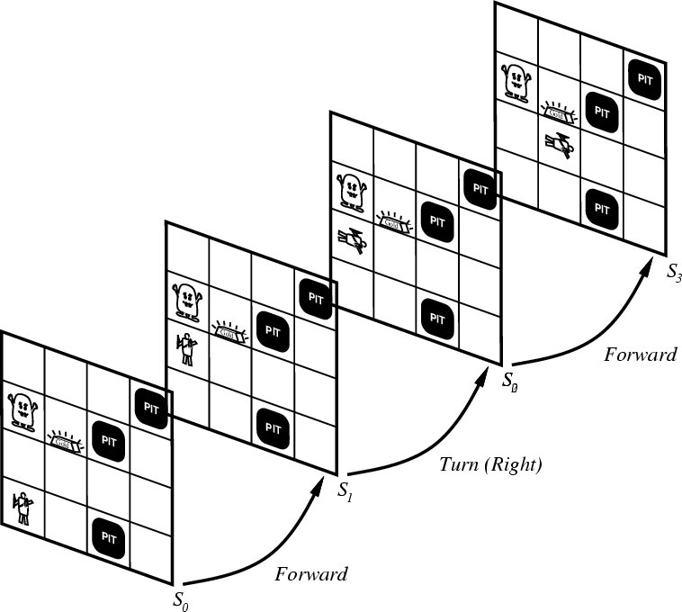
Representing change
Representing change in the world in logic can be tricky.
One way is just to change the KB
Add and delete sentences from the KB to reflect changes
How do we remember the past, or reason about changes?
Situation calculus is another way
A situation is a snapshot of the world at some instant in time
When the agent performs an action A in situation S1, the result is a new situation S2.

Slide 127
Situations

Slide 128
Situation calculus
A situation is a snapshot of the world at an interval of time during which nothing changes
Every true or false statement is made with respect to a particular situation.
Add situation variables to every predicate.
at(Agent,1,1) becomes at(Agent,1,1,s0): at(Agent,1,1) is true in situation (i.e., state) s0.
Alternatively, add a special 2nd-order predicate, holds(f,s), that means “f is true in situation s.” E.g., holds(at(Agent,1,1),s0)
Add a new function, result(a,s), that maps a situation s into a new situation as a result of performing action a. For example, result(forward, s) is a function that returns the successor state (situation) to s
Example: The action agent-walks-to-location-y could be represented by
(∀x)(∀y)(∀s) (at(Agent,x,s) ∧ ¬onbox(s)) → at(Agent,y,result(walk(y),s))

Slide 129
Deducing hidden properties
From the perceptual information we obtain in situations, we can infer properties of locations
∀l,s at(Agent,l,s) ∧ Breeze(s) → Breezy(l)
∀l,s at(Agent,l,s) ∧ Stench(s) → Smelly(l)
Neither Breezy nor Smelly need situation arguments because pits and Wumpuses do not move around

Slide 130
Deducing hidden properties II
We need to write some rules that relate various aspects of a single world state (as opposed to across states)
There are two main kinds of such rules:
Causal rules reflect the assumed direction of causality in the world:
(∀l1,l2,s) At(Wumpus,l1,s) ∧ Adjacent(l1,l2) → Smelly(l2)
(∀ l1,l2,s) At(Pit,l1,s) ∧ Adjacent(l1,l2) → Breezy(l2)
Systems that reason with causal rules are called model-based reasoning systems
Diagnostic rules infer the presence of hidden properties directly from the percept-derived information. We have already seen two diagnostic rules:
(∀ l,s) At(Agent,l,s) ∧ Breeze(s) → Breezy(l)
(∀ l,s) At(Agent,l,s) ∧ Stench(s) → Smelly(l)

Slide 131
Representing change: The frame problem
Frame axioms: If property x doesn’t change as a result of applying action a in state s, then it stays the same.
On (x, z, s) ∧ Clear (x, s) → On (x, table, Result(Move(x, table), s)) ∧ ¬On(x, z, Result (Move (x, table), s))
On (y, z, s) ∧ y≠ x → On (y, z, Result (Move (x, table), s))
The proliferation of frame axioms becomes very cumbersome in complex domains

Slide 132
The frame problem II
Successor-state axiom: General statement that characterizes every way in which a particular predicate can become true:
Either it can be made true, or it can already be true and not be changed:
On (x, table, Result(a,s)) ↔ [On (x, z, s) ∧ Clear (x, s) ∧ a = Move(x, table)] ∧ [On (x, table, s) ∧ a ≠ Move (x, z)]
In complex worlds, where you want to reason about longer chains of action, even these types of axioms are too cumbersome
Planning systems use special-purpose inference methods to reason about the expected state of the world at any point in time during a multi-step plan

Slide 133
Qualification problem
Qualification problem:
How can you possibly characterize every single effect of an action, or every single exception that might occur?
When I put my bread into the toaster, and push the button, it will become toasted after two minutes, unless…
The toaster is broken, or…
The power is out, or…
I blow a fuse, or…
A neutron bomb explodes nearby and fries all electrical components, or…
A meteor strikes the earth, and the world we know it ceases to exist, or…

Slide 134
Ramification problem
Similarly, it’s just about impossible to characterize every side effect of every action, at every possible level of detail:
When I put my bread into the toaster, and push the button, the bread will become toasted after two minutes, and…
The crumbs that fall off the bread onto the bottom of the toaster over tray will also become toasted, and…
Some of the aforementioned crumbs will become burnt, and…
The outside molecules of the bread will become “toasted,” and…
The inside molecules of the bread will remain more “breadlike,” and…
The toasting process will release a small amount of humidity into the air because of evaporation, and…
The heating elements will become a tiny fraction more likely to burn out the next time I use the toaster, and…
The electricity meter in the house will move up slightly, and…

Slide 135
Knowledge engineering!
Modeling the “right” conditions and the “right” effects at the “right” level of abstraction is very difficult
Knowledge engineering (creating and maintaining knowledge bases for intelligent reasoning) is an entire field of investigation
Many researchers hope that automated knowledge acquisition and machine learning tools can fill the gap:
Our intelligent systems should be able to learn about the conditions and effects, just like we do!
Our intelligent systems should be able to learn when to pay attention to, or reason about, certain aspects of processes, depending on the context!

Slide 136
Preferences among actions
A problem with the Wumpus world knowledge base that we have built so far is that it is difficult to decide which action is best among a number of possibilities.
For example, to decide between a forward and a grab, axioms describing when it is OK to move to a square would have to mention glitter.
This is not modular!
We can solve this problem by separating facts about actions from facts about goals. This way our agent can be reprogrammed just by asking it to achieve different goals.

Slide 137
Preferences among actions
The first step is to describe the desirability of actions independent of each other.
In doing this we will use a simple scale: actions can be Great, Good, Medium, Risky, or Deadly.
Obviously, the agent should always do the best action it can find:
(∀a,s) Great(a,s) → Action(a,s)
(∀a,s) Good(a,s) ∧ ¬(∃b) Great(b,s) → Action(a,s)
(∀a,s) Medium(a,s) ∧ (¬(∃b) Great(b,s) ∨ Good(b,s)) → Action(a,s)
...

Slide 138
Preferences among actions
We use this action quality scale in the following way.
Until it finds the gold, the basic strategy for our agent is:
Great actions include picking up the gold when found and climbing out of the cave with the gold.
Good actions include moving to a square that’s OK and hasn't been visited yet.
Medium actions include moving to a square that is OK and has already been visited.
Risky actions include moving to a square that is not known to be deadly or OK.
Deadly actions are moving into a square that is known to have a pit or a Wumpus.

Slide 139
Goal-based agents
Once the gold is found, it is necessary to change strategies. So now we need a new set of action values.
We could encode this as a rule:
(∀s) Holding(Gold,s) → GoalLocation([1,1]),s)
We must now decide how the agent will work out a sequence of actions to accomplish the goal.
Three possible approaches are:
Inference: good versus wasteful solutions
Search: make a problem with operators and set of states
Planning: to be discussed later

